Slide 1
ADOBE DEVCRAFT
TEAM NAME: Akatsuki
夜明け

Slide 2


CHALLENGES
1.TEXT EXTRACTION FROM PDF FORMAT
2.TOKENIZATION OF THE EXTRACTED TEXT
3.MODEL SELECTION
4.FINE TUNING THE PRETRAINED MODEL
5.EVALUATION OF THE MODEL USING ACCURATE METRICS
6.DEPLOYMENT OF THE MODEL

Slide 3



SOLUTION
01
We Used Python libraries like Py2PDF for text extraction which can extract text eficently
We Used BERT Tokenizer for the Tokenization process.
02
We used zero shot classification model named knowledgator/comprehend_it-base from hugging face for document classification purpose
03
We fine tuned our model by training on the given dataset and passing valid training arguments .
04
Build an Interface using Streamlit Platform which takes input PDF files and outputs the model results .
05

Slide 4
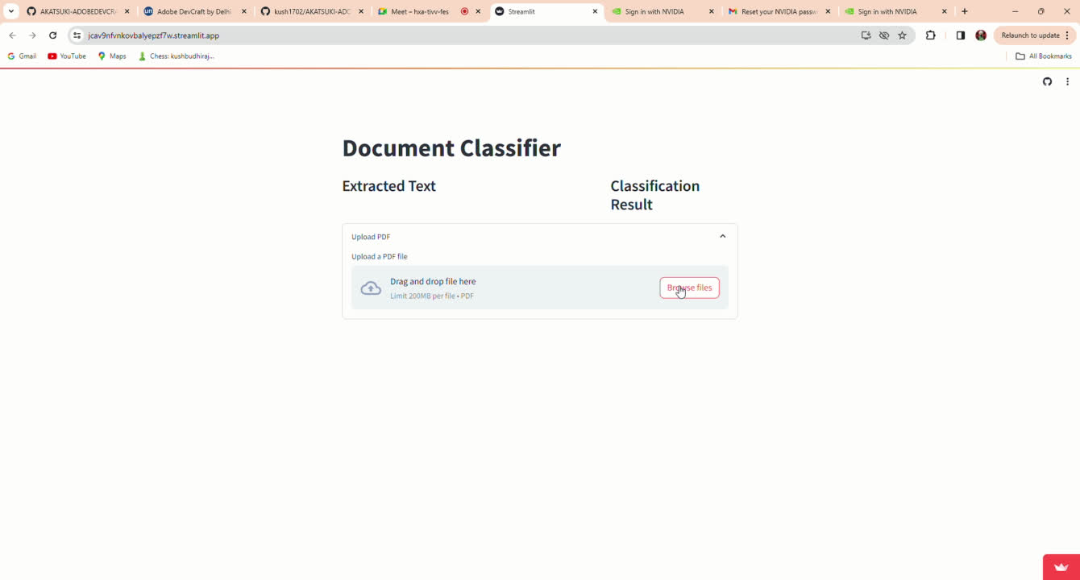
END PRODUCT DEMONSTRATION

Slide 5
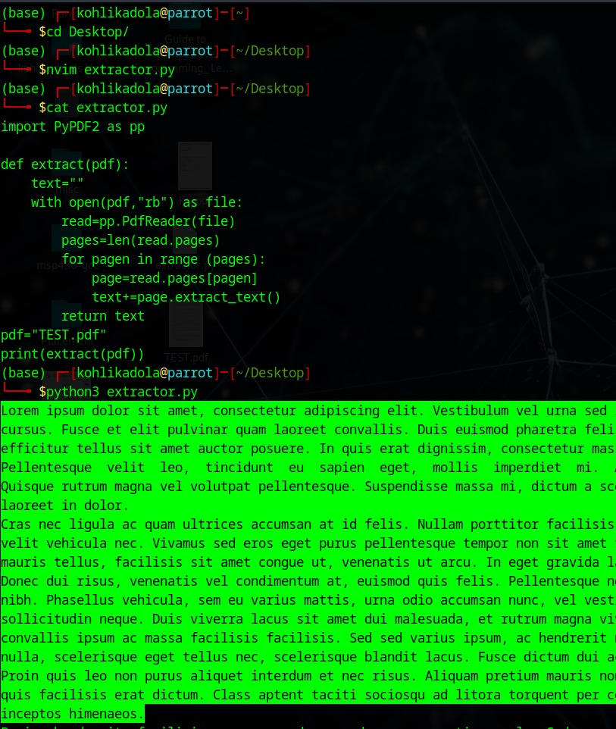
TEXT EXTRACTION
The Python code utilizes the PyPDF2 library to extract text from a PDF document. PDF, which stands for Portable Document Format, is a widely used file format for presenting documents in a manner independent of application software, hardware, and operating systems. The code takes a PDF file as input and returns the extracted text from all its pages.

Slide 6

BERT TOKENIZER
The BERT tokenizer automatically breaks down input text into subword tokens. This process ensures that the model receives a consistent and standardized input format across different tasks and datasets.
One of the key advantages of the BERT tokenizer is its ability to generate contextualized word embeddings. By encoding each token with positional and segment embeddings, the tokenizer preserves the contextual information necessary for understanding the meaning of words in their surrounding context.

Slide 7

MODEL:COMPREHEND_IT_BASE
Text classification model designed for multi-label text classification tasks, with output scoring. Works in zero and few-shot learning settings. Could be used for:
Text classification
Reranking of search results
Named-entity classification
Relation classification
Entity linking
Q&A

Slide 8


ZERO SHOT CLASSIFICATION
Zero-shot classification is a machine learning approach in which a model can classify data into multiple classes without any specific training examples for those classes. This method, which leverages a pre-trained language model, can be thought of as an instance of transfer learning which generally refers to using a model trained for one task in a different application than what it was originally trained for.
We have used the BART (Bidirectional and Auto-Regressive Transformers) language model available in the transformers library in hugging face. It is a denoising autoencoder pre-trained on a large corpus

Slide 9
FINE TUNING
Fine-tuning refers to the process of further training a pre-trained machine learning model on a specific task or dataset. In this process, the model's weights are adjusted based on the new task-specific data. Fine-tuning is typically performed using techniques like transfer learning. By fine-tuning a pre-trained model, practitioners can improve performance on a new task, even when labeled data for the new task is limited.

Slide 10
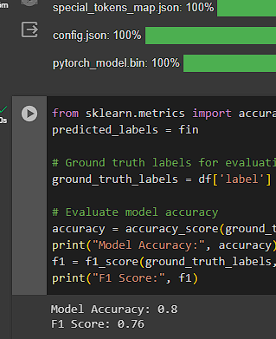
EVALUATION
ACCURACY: 80%
F1 SCORE: 0.76

Slide 11



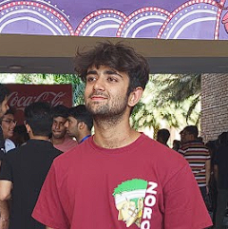
MEET OUR TEAM
ARYAN AARAV
MAYANK KUMAR CHOUDHARY
AVNISH ANKUSH KOHLI
AVNISH ANKUSH KOHLI
MAYANK KUMAR CHOUDHARY
KUSH BUDHIRAJA

Slide 12





CONTACT
9821654429 , 9310839524
Github--adobe devcraft github link
aryan.aarav.ug21@nsut.ac.in
WORKING LINK-- https://jcav9nfvnkovbalyepzf7w.streamlit.app/

